Slide 1
EECE.3220 Data Structures
Instructor:
Dr. Michael Geiger
Spring 2017
Lecture 28:
Binary trees

Slide 2
Lecture outline
Announcements/reminders
Will likely post Program 4 (stacks) and Program 5 (queues) together
P4 to be due next Friday (10/14), P5 due 10/21
Today’s lecture
Review: C++ strings
Binary trees

Slide 3
Review: Strings
String data type found in <string> library
Concepts to work with strings
Relational operators: ==, !=, <, >, <=, >=
Character-by-character comparison using ASCII
Concatenation: +, +=
Choosing single character: [], at()
at() provides boundary checking
Substrings: substr() function
If s1 = “ECE 264”
→ s1.substr(0,3) = “ECE” → 3 chars starting at position 0
s1.substr(4) = “ 264” → all chars from position 4 to end of string
Checking string length: length(), empty() functions

Slide 4
Justifying trees
Linked data structures efficiently use space
Easier to dynamically grow/shrink than array-based structures
Array-based structures are easier to search efficiently
Linked lists require linear search
Arrays (if sorted) can use binary search
Trees: linked structures that can be searched in binary manner

Slide 5
Binary Search Tree
Consider the following ordered list of integers
Examine middle element
Examine left, right sublist (maintain pointers)
(Recursively) examine left, right sublists
13
28
35
49
62
66
80

Slide 6
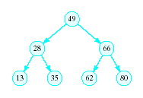
Binary Search Tree
Redraw the previous structure so that it has a treelike shape – a binary tree

Slide 7
Trees
A data structure which consists of
a finite set of elements called nodes or vertices
a finite set of directed arcs which connect the nodes
If the tree is nonempty
one of the nodes (the root) has no incoming arc
every other node can be reached by following a unique sequence of consecutive arcs

Slide 8
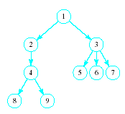
Trees
Tree terminology
Root node
Children of the parent (3)
Siblings to each other
Leaf nodes

Slide 9
Binary Trees
Each node has at most two children
Useful in modeling processes where
a comparison or experiment has exactly two possible outcomes
the test is performed repeatedly
Example
Multiple coin tosses
Decision trees where each decision is yes/no (example: guessing game)

Slide 10
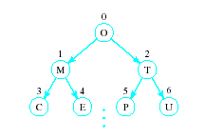
Array Representation of Binary Trees
Store the i^{th} node in the i^{th} location of the array

Slide 11
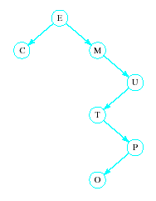
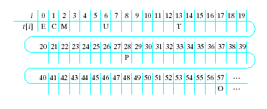
Array Representation of Binary Trees
Works OK for complete trees
Every level of tree is full
Not for sparse trees

Slide 12
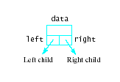
Linked Representation of Binary Trees
Uses space more efficiently
Provides additional flexibility
Each node has two links
one to the left child of the node
one to the right child of the node
if no child node exists for a node, the link is set to NULL

Slide 13
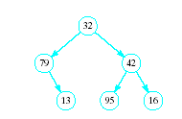
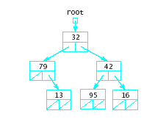
Linked Representation of Binary Trees
Example

Slide 14
Review: recursion
Recursive functions call themselves
A recursive function has two parts
Anchor / base case: function value is defined for one or more specific argument values
Inductive / recursive case: function value for current argument value defined in terms of previously defined function values and/or arguments
Example: Recursive power function
double power(double x, unsigned n){
if (n == 0)
return 1.0;
else
return x * power(x, n – 1);
}

Slide 15
Binary Trees as Recursive Data Structures
A binary tree is either empty …
or
Consists of
a node called the root
root has pointers to two disjoint binary (sub)trees called …
right (sub)tree
left (sub)tree
Anchor
Inductive step
Which is either empty … or …
Which is either empty … or …

Slide 16
Tree Traversal is Recursive
If the binary tree is empty then do nothing
Else N: Visit the root, process data L: Traverse the left subtree R: Traverse the right subtree
The "anchor"
The inductive step

Slide 17
Traversal Order
Three possibilities for inductive step …
Left subtree, Node, Right subtree the inorder traversal
Node, Left subtree, Right subtree the preorder traversal
Left subtree, Right subtree, Node the postorder traversal

Slide 18
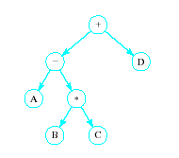
Traversal Order
Given expression A – B * C + D
Represent each operand as
The child of a parent node
Parent node, representing the corresponding operator

Slide 19
Traversal Order
Inorder traversal produces infix expression A – B * C + D
Preorder traversal produces the prefix expression + - A * B C D
Postorder traversal produces the postfix or RPN expression A B C * - D +

Slide 20
ADT Binary Search Tree (BST)
Collection of Data Elements
binary tree
each node x,
value in left child of x ≤ value in x ≤ in right child of x
Basic operations
Construct an empty BST
Determine if BST is empty
Search BST for given item

Slide 21
ADT Binary Search Tree (BST)
Basic operations (continued)
Insert a new item in the BST
Maintain the BST property
Delete an item from the BST
Maintain the BST property
Traverse the BST
Visit each node exactly once
The inorder traversal must visit the values in the nodes in ascending order

Slide 22
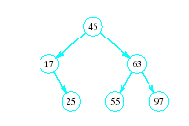
BST Searches
Search begins at root
If that is desired item, done
If item is less, move down left subtree
If item searched for is greater, move down right subtree
If item is not found, we will run into an empty subtree

Slide 23
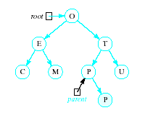
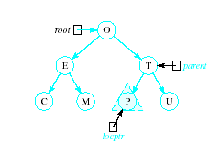
Inserting into a BST
Insert function
Uses modified version of search to locate insertion location or already existing item
Pointer parent trails search pointer locptr, keeps track of parent node
Thus new node can be attached to BST in proper place
R

Slide 24
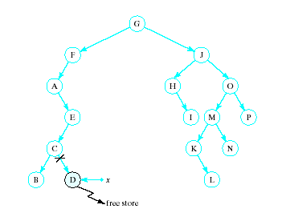
Recursive Deletion
Three possible cases to delete a node, x, from a BST
1. The node, x, is a leaf

Slide 25
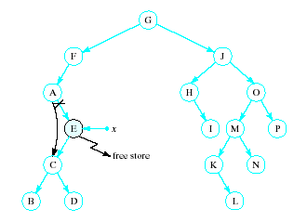
Recursive Deletion
2. The node, x has one child

Slide 26
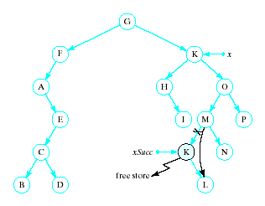
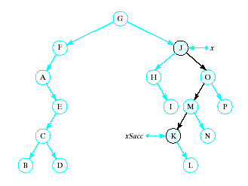
Recursive Deletion
x has two children
Delete node pointed to by xSucc as described for cases 1 and 2
Replace contents of x with inorder successor
K

Slide 27
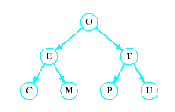
Problem of Lopsidedness
Tree can be balanced
each node except leaves has exactly 2 child nodes

Slide 28
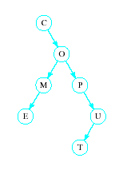
Problem of Lopsidedness
Trees can be unbalanced
not all nodes have exactly 2 child nodes

Slide 29
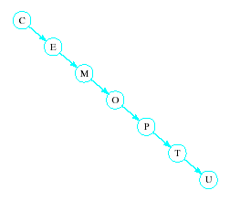
Problem of Lopsidedness
Trees can be totally lopsided
Suppose each node has a right child only
Degenerates into a linked list
Processing time affected by "shape" of tree

Slide 30
Final notes
Next time:
More on binary trees
Reminders:
Will likely post Program 4 (stacks) and Program 5 (queues) together
P4 to be due next Friday (10/14), P5 due 10/21

Slide 31
Acknowledgements
These slides are adapted from slides provided with the course textbook:
Larry Nyhoff, ADTs, Data Structures, and Problem Solving with C++, 2nd edition, 2005, Pearson/Prentice Hall. ISBN: 0-13-140909-3

