Slide 1
EECE.4810/EECE.5730
Operating Systems
Instructor:
Dr. Michael Geiger
Spring 2017
Lecture 13:
Midterm Exam Preview

Slide 2
Lecture outline
Announcements/reminders
  Midterm attendance poll (almost) complete
    I’ve directly e-mailed missing students
  HW 3 due 3:15 PM today
    No late submissions accepted
  Project 1 coming …
Today’s lecture: midterm exam preview
  Schedule
  Exam guidelines
  Review of relevant material

Slide 3
Midterm schedule
Main time: W 3/8, 2-5 PM, Olney 517
  You must take the exam at this time if you are available
2nd time: Th 3/9, 9 AM-12 PM, Pasteur 411
  This time is only for students who are unavailable Wednesday
3rd time: Th 3/9, 12-3 PM, Pasteur 413
  This time is only for students who are unavailable for the first two times
If you are unavailable at all 3 times, contact me directly to schedule your exam
  No exams will be scheduled on Friday, 3/10

Slide 4
Midterm exam notes
Allowed two 8.5” x 11” double-sided sheets of notes
No other notes; no electronic devices (calculator, phone)
Exam will last 3 hours—please be on time
Covers lectures 2-12
6 questions, each with multiple parts
  Process management (creation, deletion, etc.)
  Inter-process communication
  General multithreading
  Synchronization
  Scheduling
  Memory management
Formats include short answer (i.e., explain concept) or problem-solving (i.e. 1 correct numeric answer)
EECE.5730 students will have additional work on some problems

Slide 5
Test policies
Prior to passing out exam, your instructor will verify that you only have two note sheets
  If you have >2 sheets, I will take all notes
You will not be allowed to remove anything from your bag after you receive your exam
  If you need an additional pencil, eraser, or piece of scrap paper during the exam, ask me
Only one person will be allowed to use the bathroom at a time
  You must leave your cell phone either with me or clearly visible on the table near your seat

Slide 6
Review: Processes
Process: program in execution
  1+ running pieces of code (threads) + everything code can read/write
    Program counter
    Registers
    Address space
Address space: all code/data stored in memory
  Text section: code
  Data section: global variables
  Stack: temporary data related to functions
  Heap: dynamically allocated data

Slide 7
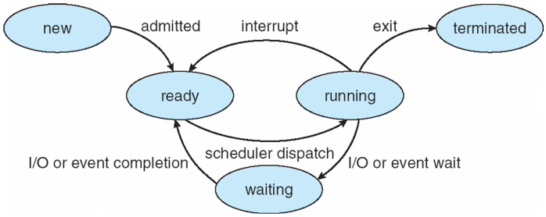
Review: Process State
new: Process is being created
running: Instructions are being executed
waiting: Process waiting for some event to occur
ready: Process waiting to be assigned to a processor
terminated: Process has finished execution

Slide 8
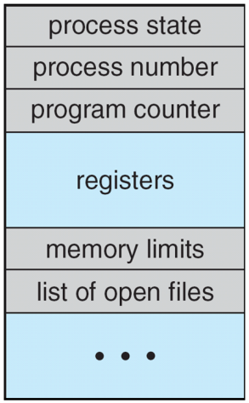
Review: Process Control Block (PCB)
Stored in memory
Used by OS to track process
Some info updated with every change
  Process state
  Scheduling queue pointers
  Accounting info
  Memory management
  I/O status,
  File list
Some info updated on context switch
  Running → waiting/ready state
  Save copies of PC, regs to PCB
  Restored when running again

Slide 9
Review: Process creation
Each process has to be created by another process
  Creator is called parent process
  Created process is child process
Children can create other processes, forming process tree
Parent/child processes may share resources
Parent/child processes may execute concurrently, or parent may wait for child to terminate

Slide 10
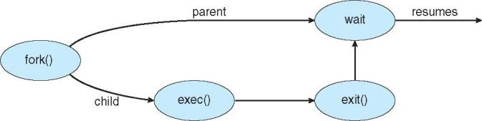
Review: Process creation (cont.)
Address space
  Initially, child duplicate of parent
  Child can load a separate program
UNIX examples
  fork() system call creates new process
  exec() system call used after a fork() to replace the process’ memory space with a new program

Slide 11
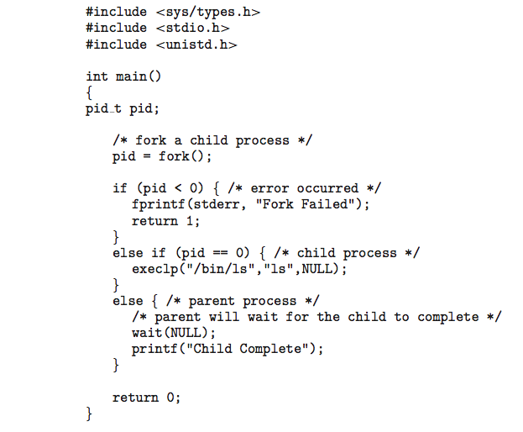
Review: Forking Separate Process
fork() return value
  <0 if error
  0 if child process
    Remember, child initially copy of parent
  >0 if parent
    Actually returns PID of child
Child starts new executable using exec() or variation
  execlp(): first argument is file to run
  Others are arguments to that executable
  Last execlp() arg must be NULL

Slide 12
Review: Forking Separate Process
Parent uses wait() system call to wait for child to finish
  If expecting child to return status of completion, argument to wait() is address of int
  i.e. wait(&status);
Process ends using exit() system call
  May be explicit, implicit (return from main → exit())
  Returns status data from child to parent (via wait())

Slide 13
Review: Process Termination
Parent may wait() for child termination
  wait() returns child PID, passes return status through pointer argument
pid = wait(&status);
If child terminates before parent invokes wait(), process is a zombie
If parent terminated without wait() , process is an orphan
  Return status must be checked
  In Linux, orphans assigned init as parent

Slide 14
Review: Interprocess Communication
May want processes to cooperate for
  Information sharing (i.e., shared files)
  Computation speedup (if procs can run in parallel)
  Modularity (divide up program/system)
  Convenience
Cooperating processes need 1 of 2 forms of interprocess communication (IPC)
  Shared memory
  Message passing

Slide 15
Review: IPC Models
(a) Message passing (b) Shared memory

Slide 16
Review: Interprocess Communication
Shared memory
  Communication largely process-managed after OS used to set up shared region
Message passing
  OS responsible for send/receive primitives
  Direct communication: processes send messages directly to one another
  Indirect communication: processes send to/receive from mailboxes

Slide 17
Review: Threads
Thread: active sequence of instructions
  Basic unit of CPU utilization
  Thread creation is lightweight
  Multiple threads in same process can share address space
    Each thread needs own PC, register copies, stack + SP
Threads provide concurrency within application
  HW support necessary for parallelism
Major issue: non-deterministic ordering
  Solutions require atomic operations
  Avoid race condition: solution depends on timing/ordering of earlier events

Slide 18
Review: Critical section
Code section that needs to be run atomically with respect to selected other pieces of code
If A and B are critical sections with respect to each other, multiple threads can’t interleave events from A and B
  A and B mutually exclude each other
  A and B often same piece of code
Critical sections must be atomic with respect to each other because they access shared resource

Slide 19
Review: Locks
A lock (or mutex) prevents another thread from entering a critical section
  “Lock fridge while checking milk & shopping”
Two operations:
  lock(): wait until lock is free, then acquire it
  do {
  if (lock is free) { // code in red
  acquire lock // is atomic
  break out of loop
  }
  } while (1);
  unlock(): release lock
To minimize waiting, implement shared queue
  Can lock entire queue or use fine-grained locking

Slide 20
Review: Condition variables
Avoid busy waiting by enabling thread to sleep inside critical section by (steps in red are atomic):
  Release lock
  Put thread on waiting list
  Go to sleep
  After being woken, call lock()
Each condition variable tracks list of threads waiting on that specific condition
Each condition variable associated with lock

Slide 21
Review: Condition variable operations
wait()
  Atomically release lock, add thread to waiting list, then go to sleep
  Thread must hold lock when calling wait()
signal()
  Wake up one thread waiting on condition variable
  If no thread waiting, does nothing
broadcast()
  Wake up all threads waiting on condition variable
  If no thread waiting, does nothing

Slide 22
Review: Semaphores
Generalized lock/unlock
Definition
  Integer initialized to user-specific value
  Supports two atomic operations
    down(): wait for semaphore value to become positive, then atomically decrement by 1
      Text calls this wait(); originally P()
      To avoid busy waiting, semaphore can maintain list of waiters
      Process calls block() once added to list
    up(): increment semaphore value
      Text calls this signal(); originally V()
      If maintaining list, remove process from list and wake up
      wakeup() call signals blocked process

Slide 23
Review: Using semaphores
Semaphore types
  Counting semaphore: Range of values unrestricted
  Binary semaphore: values == 0 or 1 (same as lock)
Can implement both mutual exclusion and ordering
Mutual exclusion
  Initialize semaphore to 1
  down();
  critical section
  up();
Ordering
  Typically initialize to 0
  Say thread A must wait for thread B
  Thread A Thread B
  down(); complete task
  continue work up();

Slide 24
Review: Deadlock
Cyclical wait for resources, which prevents involved threads from making progress
Necessary conditions
  Limited resource: not enough to serve all threads simultaneously
  Hold and wait: threads hold resources while waiting to acquire other resources
  No preemption: thread system can’t force one thread to give up resources
  Cyclical chain of requests

Slide 25
Review: Deadlock prevention
Eliminate one of four necessary conditions
Increase resources to decrease waiting
Eliminate hold and wait: move resource acquisition to beginning
  If can’t (atomically) get all resources, release everything
  Phase 1a: acquire all resources
  Phase 1b: while (!done) {work}
  Phase 2: release all resources

Slide 26
Review: Banker’s Algorithm
Similar to reserving all resources at beginning, but with more concurrency
State maximum resource needs in advance (without acquiring)
May block when thread attempts to acquire resource
General structure
  Phase 1a: state maximum resource need
  Phase 1b: while (!done) {
  acquire some resource (block
  if not safe)
  work
  }
  Phase 2: release all resources

Slide 27
Review: Scheduling
Scheduling CPU burst times according to one or more metrics
Classifying schedulers by decision timing
  When is next process chosen to run?
  Nonpreemptive scheduler
    Only make decision when process switches from running → waiting state (interrupt, I/O request, etc.)
    Processes are not forced to give up CPU
  Preemptive scheduler
    Make decision when new process arrives in ready queue (waiting → ready) or predefined time quantum expires (running → ready)
    Processes can be forced to give up CPU

Slide 28
Review: Scheduling Criteria
Several possible, often conflicting goals
Want to maximize
  CPU utilization: keep CPU as busy as possible
  Throughput: rate at which processes complete per time unit
  Fairness: ensure CPU shared (relatively) equally
Want to minimize
  Turnaround time: amount of time to execute a particular process, from arrival to completion (includes waiting time)
    Sometimes called latency or response time …
    … although our text defines response time as time to first “response” (output) from program, not completion
  Waiting time: amount of time a process has been waiting in the ready queue
  Starvation: Thread/process does not get access to resources
    Want to avoid, not just minimize!

Slide 29
Review: Scheduling algorithms
First-come, first-served (FCFS) or FIFO
  Schedule tasks in order they arrive in ready queue
Shortest job first (SJF)
  Always schedule job with shortest remaining burst
Shortest remaining time first (SRTF) or STCF
  Preemptive version of SJF
Priority scheduling
  Priority associated with process; highest priority 1st
Round robin
  Each process gets CPU for fixed period of time
Earliest deadline first
  Real-time scheduling algorithm

Slide 30
Review: Address spaces
Multiprogrammed system—keep multiple processes resident in main memory
OS should provide
  Address independence: same numeric address used in multiple processes, kept logically distinct
  Protection: one process can’t access another’s address space unless explicitly given access
  Virtual memory: address space larger than physical memory
OS typically binds relocatable virtual addresses to physical address at execution time
  Requires dynamic address translation on every reference

Slide 31
Review: Forms of address translation
Base and bounds
  Contiguous region allocated for entire address space
Segmentation
  Address space split into variable-sized segments
Paging
  Address space split into fixed-size pages
Tradeoffs between
  Flexibility (sharing, growth, VM)
  Size of data needed to support translation
  Speed of translation

Slide 32
Review: Base and bounds
Each process allocated contiguous block for entire address space
Address space defined by two values
  Base (or relocation register): lowest PA used
  Bound (or limit): total size of address space
  Only OS can change values
  HW support: only two registers
Process sees virtual address space
0 ≤ address < bound
Simple translation: PA = VA + base

Slide 33
Review: Segmentation
Segment: contiguous region of memory
  Base & bounds = 1 segment
  Generalized segmentation allows >1 segment per program
Each process has a segment table
  Entry in table = segment
  Maps segment # to base/bounds for that segment
Segment can be anywhere in physical memory
  Each segment has: start, length, access permission
Processes can share segments
  Same start, length, same/different access permissions

Slide 34
Review: Segmentation
Notes:
This should seem a bit strange: the virtual address space has gaps in it! Each segment gets mapped to contiguous locations in physical memory, but may be gaps between segments.
This is a little like walking around in the dark, and there are huge pits in the ground where you die if you step in the pit.
But! of course, a correct program will never step off into a pit, so ok.
A correct program will never address gaps; if it does, trap to kernel and then core dump. Minor exception: stack, heap can grow. In UNIX, sbrk() increases size of heap segment. For stack, just take fault, system automatically increases size of stack.
Detail: Protection mode in segmentation table entries. For example, code segment would be read-only (only execution and loads are allowed). Data and stack segment would be read-write (stores allowed).
What must be saved/restored on context switch? Typically, segment table stored in CPU, not in memory, because it’s small.
Contents must be saved/restored.

Slide 35
Review: Segment table
Segment # | V | Base | Bounds | Access
0 | 1 | 4000 | 700 | read/exec | code segment
1 | 1 | 0 | 500 | read/write | data segment
2 | 0 | n/a | n/a |  | unused segment
3 | 1 | 2000 | 1000 | read/write | stack segment
Protection handled by segment table contents
  Valid bit (V) indicates if segment in use
  Access indicates privileges (read/write/execute)
Virtual address: segment #, offset
  Segment number must be valid
  Offset must be < bound
  If either false, trap to OS → invalid address

Slide 36
Review: Paged Translation
Manage memory in fixed size units
  Virtual memory blocks: pages
  Physical memory blocks: frames
Bitmap tracks free frames
Each process has its own page table
  Tracks translation, permissions, etc.
Translation
  Virtual address: page # & offset
  Page # indexes into page table → get frame #
  Physical address: frame # & offset
Notes:
Simpler, because allows use of a bitmap. What's a bitmap?
001111100000001100
Each bit represents one page of physical memory -- 1 means allocated, 0 means unallocated. Lots simpler than base&bounds or segmentation

Slide 37
Review: Paged Translation (Abstract)

Slide 38
Review: Paged Translation (Implementation)

Slide 39
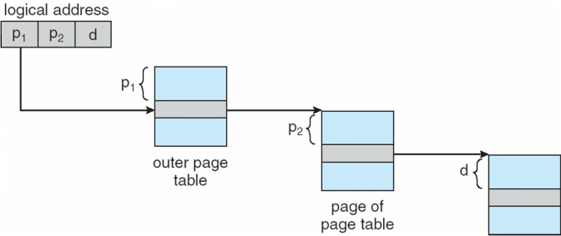
Review: Multi-level page table
Space saving technique
Outer page table points to second-level page table
Second-level page table points to physical frame
Could extend to >2 levels

Slide 40
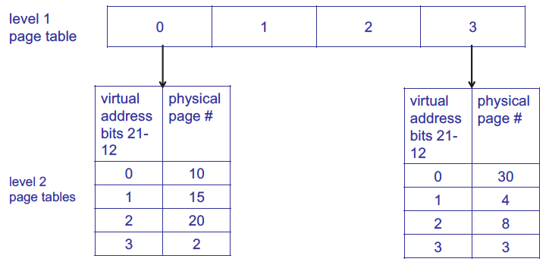
Review: Multi-level page table
1st level page table points to 2nd level page tables
Example assumes 4 KB page size, 1K PTEs at each level

Slide 41
Review: Hashed Page Tables
Common in address spaces > 32 bits
The virtual page number is hashed into a page table
  This page table contains a chain of elements hashing to the same location
Each element contains (1) the virtual page number (2) the value of the mapped page frame (3) a pointer to the next element
Virtual page numbers are compared in this chain searching for a match
  If a match is found, the corresponding physical frame is extracted

Slide 42
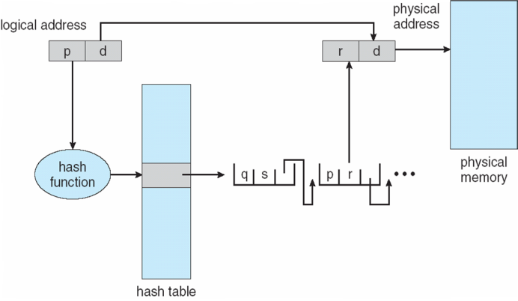
Review: Hashed Page Table

Slide 43
Review: Inverted Page Table
Rather than each process having a page table and keeping track of all possible logical pages, track all physical pages
One entry for each real page of memory
Entry consists of the virtual address of the page stored in that real memory location, with information about the process that owns that page
Decreases memory needed to store each page table, but increases time needed to search the table when a page reference occurs
Use hash table to limit the search to one — or at most a few — page-table entries
  TLB can accelerate access
But how to implement shared memory?
  One mapping of a virtual address to the shared physical address

Slide 44
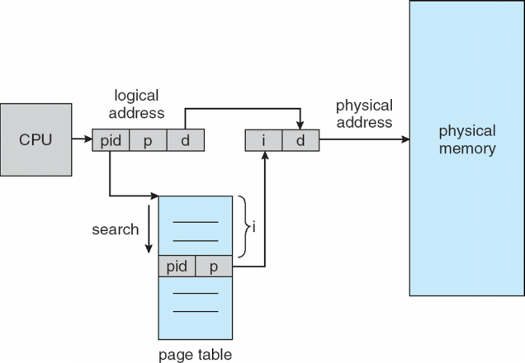
Review: Inverted Page Table Architecture

Slide 45
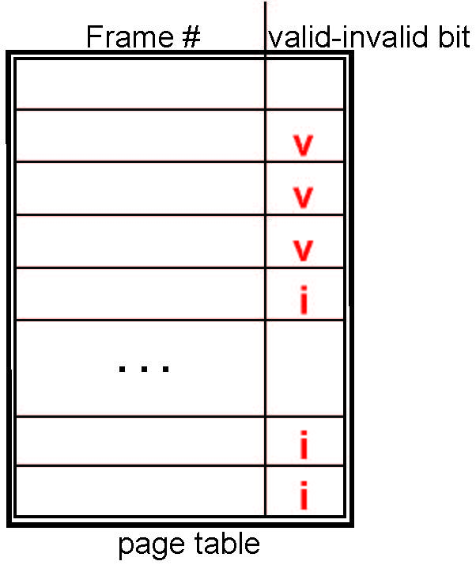
Review: Valid-Invalid Bit
With each page table entry a valid–invalid bit is associated
(v ⇒ in-memory – memory resident, i ⇒ not-in-memory)
Initially valid–invalid bit is set to i on all entries
During MMU address translation, if valid–invalid bit in page table entry is i ⇒ page fault

Slide 46
Review: Page replacement
How do we determine page to evict if physical address space is full?
  Goal: minimize page faults
Closest optimal approximation: least recently-used (LRU)
  Use reference bits to approximate LRU
  Clock algorithm commonly used to manage clearing of reference bits

Slide 47
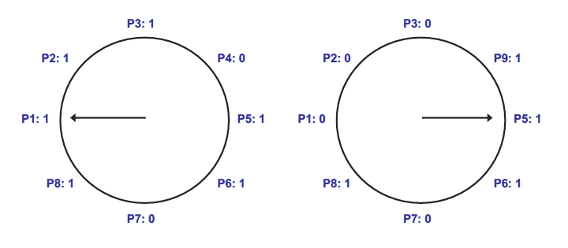
Review: Clock algorithm
In example above, 8 resident pages
Consider pages starting with P1
P4 is first non-referenced page—evicted for P9
Reference bit clear for P1-P3

Slide 48
Review: Dirty bits
What happens on eviction?
  Simplest case: evicted page written back to disk
  When is write to disk actually necessary?
    Only if page has been modified
Dirty bit tracks changed pages
  Dirty bit = 1 → page modified
How can dirty bit be used to modify eviction policy?
  More performance-effective to evict non-dirty pages—no need to take time to write to disk

Slide 49
Final notes
Next time: Midterm exam
  Please be on time for whatever exam time you’re attending
    Wed 2-5 in Olney 517 (1st choice)
    Th 9-12 in Pasteur 411 (2nd choice)
    Th 12-3 in Pasteur 413 (3rd choice)
Reminders:
  HW 3 due 3:15 PM today
    No late submissions accepted
  Project 1 coming …

